Slide 1

Chapter 2
Teachers Discovering Computers
Communications, Networks, the Internet

Slide 2
Chapter Objectives
Define communications
Identify the basic components of a communications system
Describe how and why network computers are used in schools and school districts
Explain how the Internet works
Explain how Internet services such as e-mail, newsgroups, chat rooms, and instant messaging work

Slide 3
Chapter Objectives (cont.)
Identify several types of multimedia products available on the Web
Describe the educational implications of the Internet and the World Wide Web
Describe different ways to connect to the Internet and the World Wide Web
Describe the pros and cons of Web 2.0 tools for teachers and students

Slide 4
What Is Communications?
A process in which two or more computers or devices transfer data, instructions, and information
Sometimes called telecommunications
Examples include
  Electronic mail (e-mail)
  Voice mail
  Facsimile (fax)
  Telecommuting
  Online services
  Videoconferencing
  Internet
  World Wide Web

Slide 5
Communications Networks
A communications network is a collection of computers and other equipment organized to share
  data
  Information
  Hardware
  software.
A basic communications system consists of the following equipment:
  Two computers, one to send and one to receive data
  Communications devices that send and receive data
  A communications channel over which data is sent

Slide 6
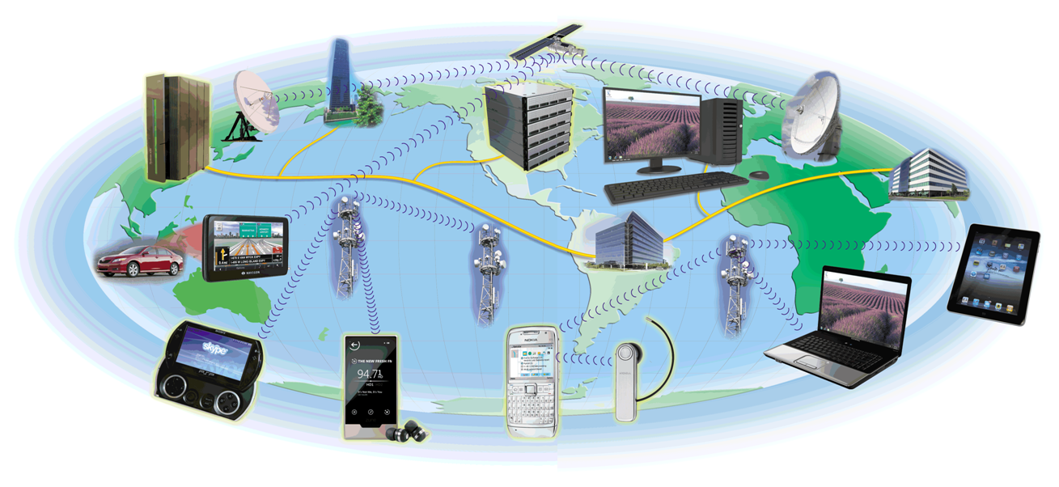
Communications Networks (cont.)
Desktop computers
servers
tablet and other mobile computers
mainframe
notebook computers
GPS receivers
notebook computers
handheld game console
Internet- enabled portable media players
smartphones

Slide 7
Communications Networks (cont.)
A communications channel is the path that data follows as the data is transmitted from the sending equipment to the receiving equipment in a communications network.
Communications channels are made up of transmission media, which are the physical materials or other means used to establish a communications channel.

Slide 8
Networking Media
The two general ways devices are connected to networks
  Wired Networking Media
  Wireless Networking Media

Slide 9
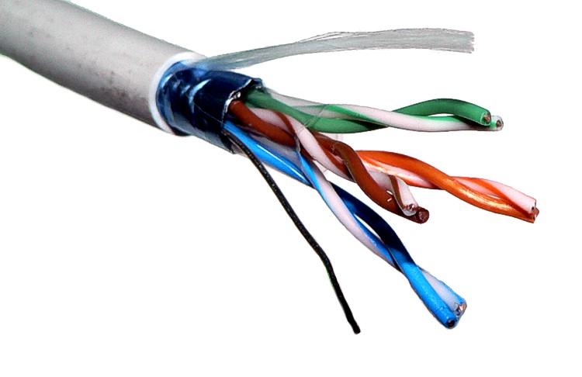
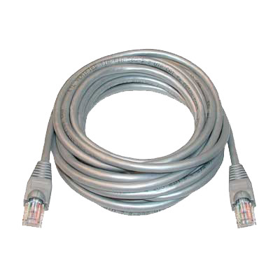
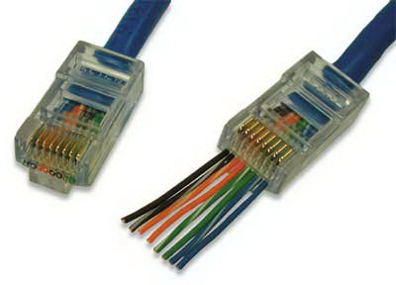
Wired Networking Media (cont.)
Twisted Pair
  made up of pairs of thin strands of insulated wire twisted together.
  Rated by category
    CAT 5
    CAT 6
RJ 45 Connector

Slide 10
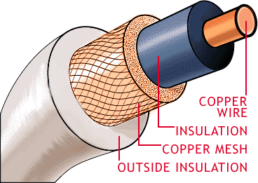
Wired Networking Media (cont.)
Coaxial Cable (coax)
  coaxial cable consists of
  Blocks electromagnetic interference better then twisted pair.

Slide 11
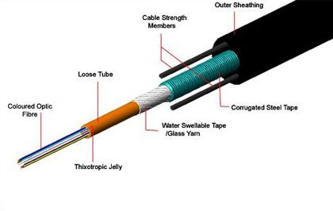
Wired Networking Media (cont.)
Fiber Optic Cable
  contains multiple— sometimes several hundred— clear glass or plastic fiber strands, each about the thickness of a human hair
  cable transfers data represented by light pulses at speeds of billions of bits per second.

Slide 12
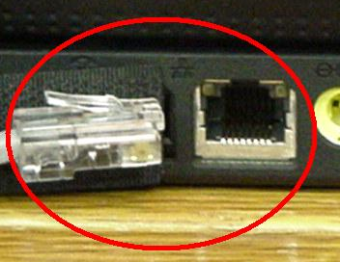
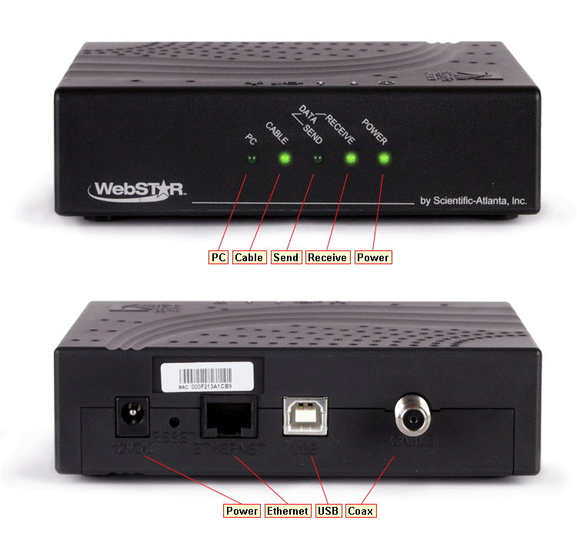
Network Adapters and Modems
A network adapter is used to connect a computer to a network (such as a home or business network).
A modem is used to connect a computer to a network over wired media

Slide 13
Wireless Networking Media
Wireless networks usually use radio signals to send data through the airwaves.
Other radio signal applications include
  Mobile phone
  Radio
  Television
Different applications use different frequencies to broadcast their information.

Slide 14
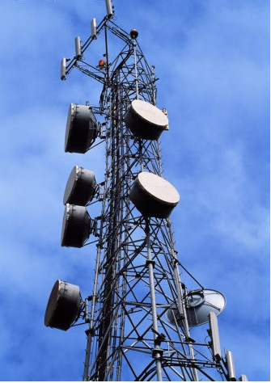
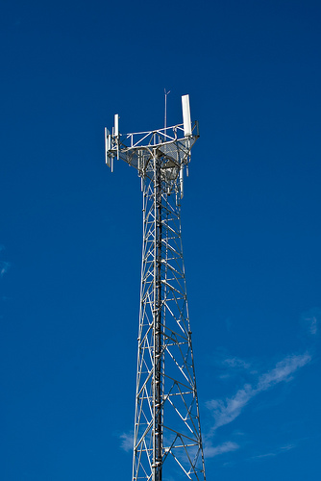
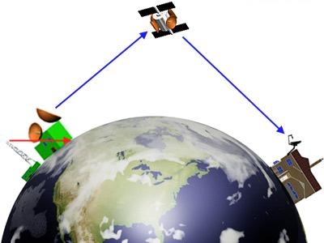
Wireless Networking Media (cont.)
Cellular radio
Microwave
Satellite

Slide 15
Network Architectures
Network Architectures: the way computers are designed to communicate
The two main types are:

Slide 16
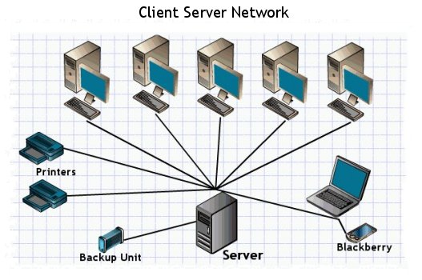
Network Architectures (cont.)
Client- server networks include
  clients, which are computers and other devices on the network that request and use network resources
  servers, which are computers that are dedicated to processing cli-ent requests.

Slide 17
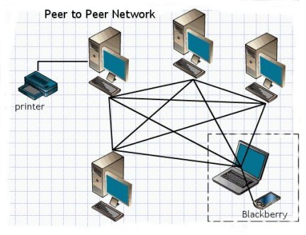
Network Architectures (cont.)
A peer- to- peer ( P2P) network
  has no central server.
  all the computers on the network work at the same functional level
  users have direct access to the computers and other devices attached to the network.

Slide 18
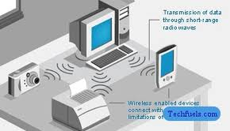
Network Size and Coverage Area
A personal area network (PAN) is a network of personal devices that is designed to enable those devices to communicate and share data.

Slide 19
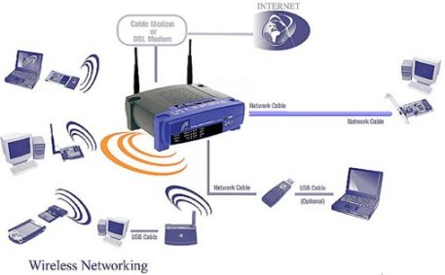
Network Size and Coverage Area (cont.)
A local area network (LAN) is a network that covers a relatively small geographical area, such as a home, an office building, or a school.
Home Networks
  Connects multiple computers in your home or home office
  Share Internet access
  Share peripherals
  Can be wired or wireless

Slide 20
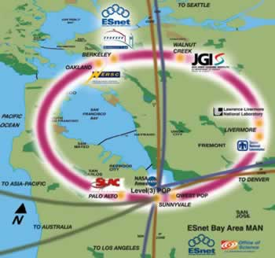
Network Size and Coverage Area (cont.)
A metropolitan area network (MAN) is a network designed to service a metropolitan area, typically a city or county.

Slide 21
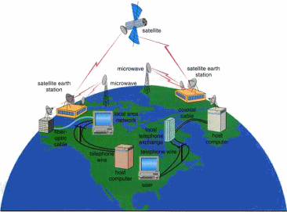
Network Size and Coverage Area (cont.)
A wide area network (WAN) is a network that covers a large geographical area.
Best example the Internet

Slide 22
Networking the Classroom, School, and District
Schools have installed networks for four reasons:
  To share hardware and software resources
  To enable communications among schools and other organizations
  To connect students and teachers to the Internet
  To use and share information and data

Slide 23
Networking the Classroom, School, and District
Wireless schools and classrooms
  We all are using wireless technologies in
    Smart phones
    Tablet computer
    Notebook computers
  Many experts believe that the future of educational computing is wireless networks, wireless tablet computers, and other wireless devices.
  This allows information to be shared without direct wired connection to the school’s network.
  Also allows wireless devices access to the world of information on the World Wide Web

Slide 24
The Benefits of Computer Networks in Education
Sharing of computer hardware, software, and data resources
Unlimited educational resources
Communicate with other educators and students

Slide 25
What is the Internet?
The Internet is a worldwide collection of networks that link together millions of businesses, governments, educational institutions, and individuals.
Each of these networks provides resources and data that add to the abundance of goods, services, and information accessible via the Internet.

Slide 26
A Brief History of the Internet
The Pentagon’s Advanced Research Projects Agency (ARPA) begins a project to network computers around the country, ARPNET.
1969 started as a network of four computers at the University of California at Los Angeles ARPNET
1972 The first e-mail is sent
1981 the IBM PC is introduced
1984 Apple introduces the McIntosh computer

Slide 27
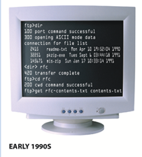

A Brief History of the Internet (cont.)
In 1989, a researcher named Tim Berners-Lee proposed the idea of the World Wide Web (WWW) as a way to organize information in the form of pages linked together through selectable text or images (today’s hyperlinks) on the screen.

Slide 28
A Brief History of the Internet (cont.)
1992 Windows 3.1 is introduced
1993 a graphic interface for the WWW is created called Mosaic. This will become Netscape Navigator.

Slide 29
The Internet Today
Backbone now provided by variety of corporations
Various organizations help define standards
  Internet Society (ISOC)
  ICANN ( Internet Corporation for Assigned Names and Numbers)
  The World Wide Web Consortium ( W3C)
Internet2 (I2)
  Extremely high-speed network
  Develop and test latest Internet technologies
  Members include more than 200 universities in the United States, along with 115 companies

Slide 30
How the Internet Works
Data is divided into packets
Routers send packets across the Internet
At the destination, the packets are reassembled into the original message
Transmission control protocol/Internet protocol (TCP/IP) is the communications protocol used by the Internet

Slide 31
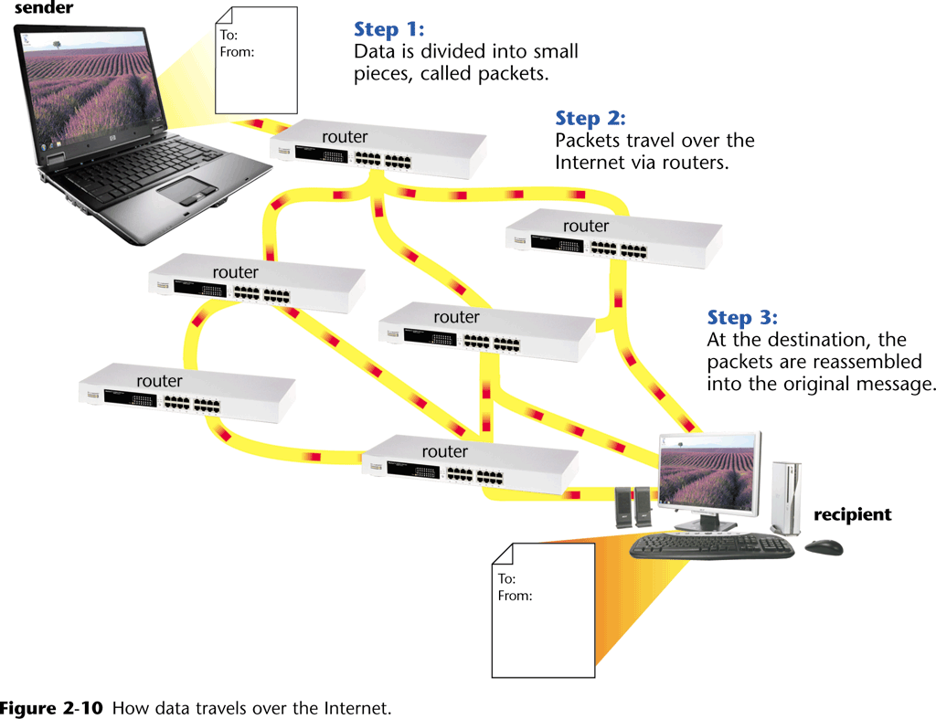
How the Internet Works (cont.)

Slide 32
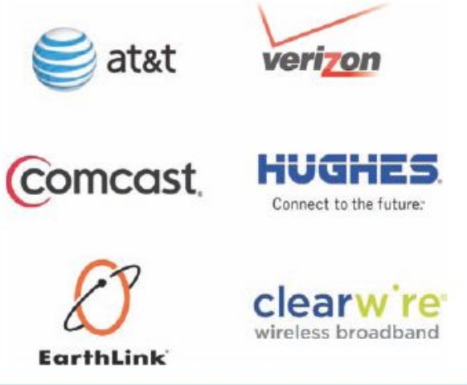
Members of The Internet Community Today
Users - People who use the Internet to retrieve content or perform online activities,
Internet service providers (ISPs) - Businesses or other organizations, including telephone, cable, and satellite companies, that provide Internet access to others,

Slide 33
Members of The Internet Community Today
Internet content providers – create and publish content to the internet.
Application service providers (ASPs) - companies that manage and distribute Web- based software services to customers over the Internet.
Infrastructure companies - The enterprises that own or operate the paths or “ roadways” along which Internet data travels, such as the Internet backbone and the communications networks connected to it.
Hardware and software companies - The organizations that make and distribute the products used with the Internet and Internet activities.

Slide 34
Members of The Internet Community Today
Governments - The ruling bodies of countries that can pass laws limiting both the information made available via Web servers located in a particular country and the access individuals residing in that country have to the Internet.

Slide 35
Connecting to the Internet
Slow speed technology
  Dial-up access
High speed technology
  Digital subscriber line (DSL)
  Cable television Internet services (CATV),
  Satellite
  Wireless Broadband
Connection is always on

Slide 36
E-mail
The transmission of messages and files via a computer network
Messages can consist of simple text or can contain attachments, such as documents, graphics, or audio/video clips
Internet access providers usually provide an e-mail program

Slide 37
E-mail
The e-mail address is a combination of
domain
name
user name
samjohnson@scsite.com

Slide 38
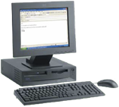
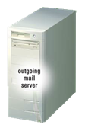
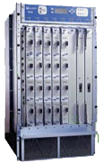
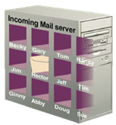
E-mail
How an e-mail message travels
outgoing mail server
incoming mail server
Internet
routers
POP 3
server

Slide 39
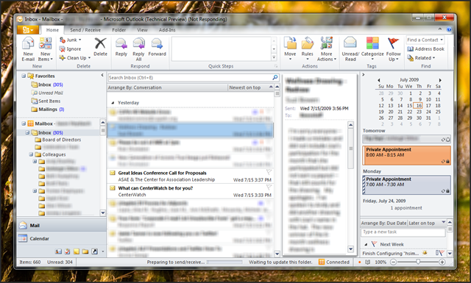
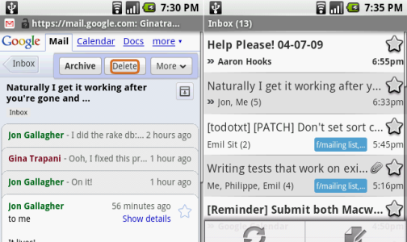
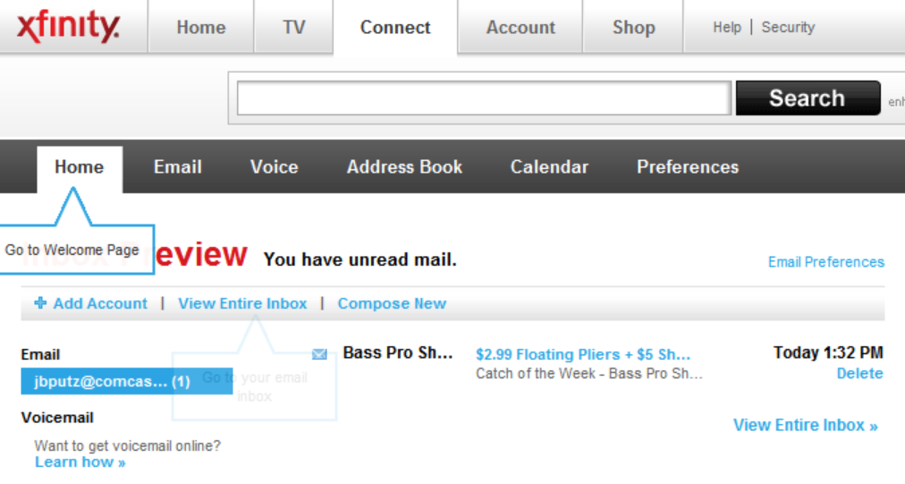
Accessing E-mail
E-mail clients are programs that allow you to send and receive e-mails.
  Different ways to display your email
    As part of a web site
    App on a smart phone
    Stand alone application.

Slide 40
Other Internet Services
FTP (file transfer protocol)
Newsgroups and Message Boards
Mailing Lists
Instant Messaging
Chat Rooms
Voice Over IP (VoIP)

Slide 41
Netiquette
Internet etiquette
  The code of acceptable behaviors users should follow while on the Internet
  A web site for netiquette http://www.albion.com/netiquette/

Slide 42
Internet Security
Firewall
Filtering software
Acceptable Use Policy (AUP)

